Slide 1
Swiggy Data Problem Statement

Slide 2
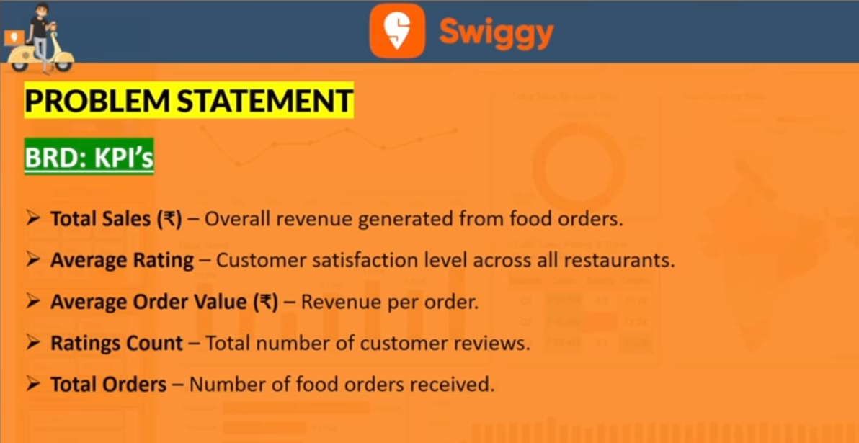

Slide 3
